Slide 1
Behavior Driven Development with SpecFlow
Lucidio Kuhn 02/27/2019

Slide 2
Why?
Have your code ever crashed at the presence of a final customer?
Have your code not delivered the results the customer wanted, even though it implemented the specification?
Have you spent more time than planned to deliver a feature?
Have you spent more time debugging than developing a feature?
Have you started working in a feature without knowing what it should be, how it should be implemented and to whom?
Have you spent too much time investigating a feature?
Are you curious about simple development methodologies with proven results?

Slide 3
Disclaimers
This presentation does not try to provide a deep insight into BDD, MDD, TDD, LCMDD, nor SpecFlow.
If you want deeper knowledge, there are good courses at Pluralsight (like the one below), and other sources.
https://app.pluralsight.com/library/courses/specflow-2-0-business-readable-automated-tests/table-of-contents

Slide 4
But… there are so many *DD methodologies! ADD BDD DDD FDD LCMDD MDD TDD UGDD
There are many *DD methodologies, seems like a new one pops every month. However, there is more commonality between them than an initial read might convey:
They are all meant to reduce risk:
Risk of developing the wrong system.
Risk of developing a buggy system.
Risk of not delivering on time / on budget.
They are ways to observe reality, identify opportunities and requirements for systems.
Most of them create, among other documents, feature descriptions:
Using a highly readable Given-When-Then format (Gherkin).
A feature description can be used to automatically generate test code scaffolding.

Slide 5
A generic *DD workflow
Market Analysis
Customer Requests
Log Monitoring
Interviews
…
*DD
Reduce Risk
Feature Descriptions (among other docs):
Feature: Feature Description
In order to accomplish a business value
As an explicit system actor
I want to do something
Scenario: Scenario Description
Given Some initial condition
When I do something
Then Something is expected
Author
DDD
Knowledge Taxonomy
Reality
Observe
LCMDD/MDD
Model Definition
Level of abstraction
Generate
WhateverDD
. . .
TDD Cycle
BDD
Deliberate Discovery
Test Code
FDD | Feature DD
RDD | Responsibility DD
UGDD | User Guide DD
ADD | Aspect DD

Slide 6
When to use what
The methodologies are not mutually exclusive.
Depending on the type of problem, some *DD are more advisable than others:
Type of Problem | Such as | *DD to use
Simple/Obvious | “Known knowns”, bugs | Plain TDD
Complicated | “Known unknowns”: features that we know must be delivered | BDD
Complex | “Unknown unknowns”: features our customers want but we don’t know | MDD/DDD
Chaotic | Emergencies with unclear cause and effect. | None: fix the problem ASAP!
TDD tries to find bugs where the system crashes while trying to give the correct result.
BDD/DDD/MDD avoids showing (flawlessly) the wrong result.
We will focus on BDD here;

Slide 7
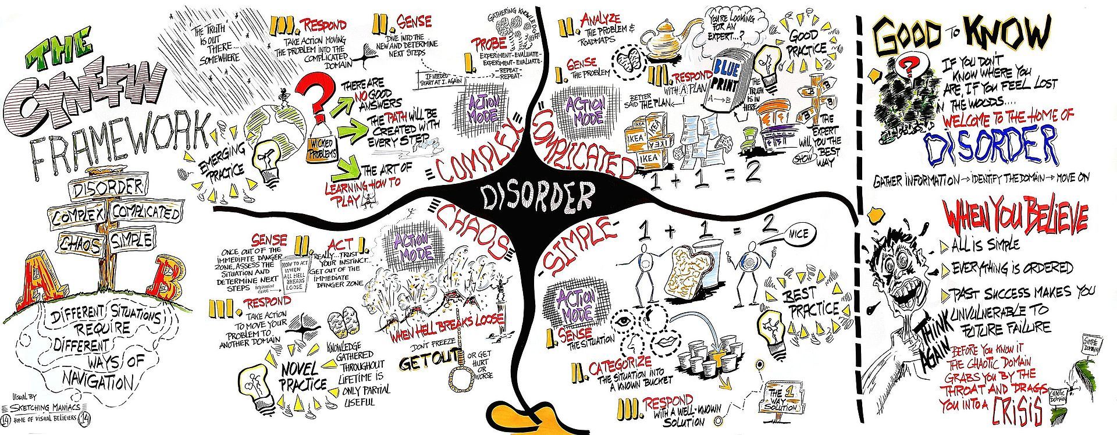
Cynefin (KUN-iv-in) A way to categorize issues

Slide 8
What is BDD
BDD takes from TDD (Test Driven Development) and goes further. It uses the same "inner cycle" from TDD.
However, with BDD we define the “behavior” beforehand, where behavior means "desired user behavior", described as a set of scenarios using an agreed-upon language.
"It is the process of approaching your design and forcing you to think about the desired outcome and API before you code.“
It has 2 parts and 3 principles.

Slide 9
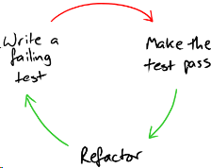
BDD Parts
Deliberate Discovery
Deliberately discover what we don't know. There are many techniques, such as:
Prototyping;
Example Mapping;
Planning Poker and many others.
Test Driven Development (TDD):
Development through very short iterations of the cycle:
Requirements are translated into test cases;
The system is improved to pass to test cases (and nothing more).

Slide 10
BDD Principles
Business and Technology should refer to the same system in the same way:
Ubiquitous language used throughout so everyone refers to the same entities the same way.
“Behavior” meaning “desired user behavior”.
The set of behaviors is the definition of Done.
Any system should have an identified, verifiable value to the business:
Every behavior should be there because it adds concretely to the business value of the system as a whole.
Up-front analysis, design and planning all have a diminishing return
It is understood that the behavior will be updated as the team learns about the scope.
Stop analysis when the number of discoveries starts diminishing.

Slide 11
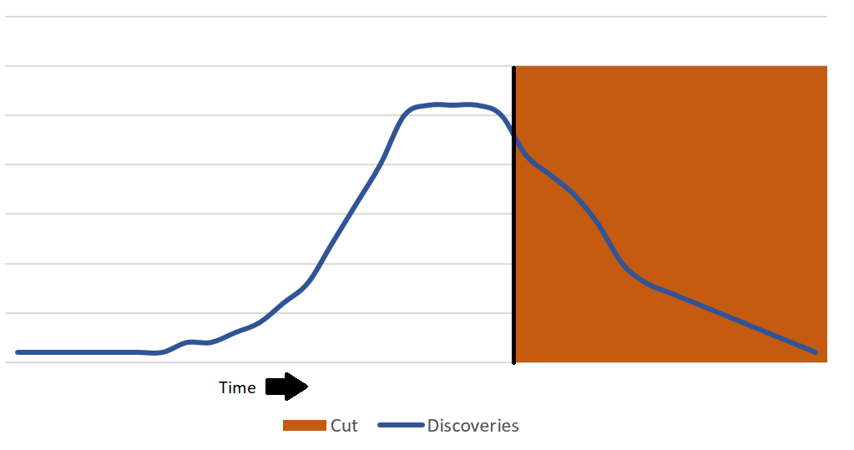
The Microwave Popcorn principle
Stop analysis when the number of discoveries starts diminishing.
This is similar to Microwave Popcorn. It takes time to start popping, then it stabilized for some time, and finally the pops start diminishing. That’s the moment to get the popcorn out of the microwave, otherwise it will burn.
Similarly, there is a moment in a project when we must stop investigating and start developing: when the number of discoveries start tapering down.
Not following this can lead to Analysis Paralysis.

Slide 12
SpecFlow
SpecFlow is an implementation of the Gherkin language for .Net.
Gherkin uses a set of special keywords to give structure and meaning to executable specifications.
SpecFlow can translate a Gherkin specification (a .feature file) into executable C# code, with parameter bindings.
Installation:
Follow instructions for "Installing the Visual Studio Extension" on SpecFlow’s Getting Started page.
Do not follow "Setting Up your SpecFlow Project", since it describes the usage of their (paid) SpecFlow+ tools.
Just because you are using SpecFlow does not mean you are doing BDD!

Slide 13
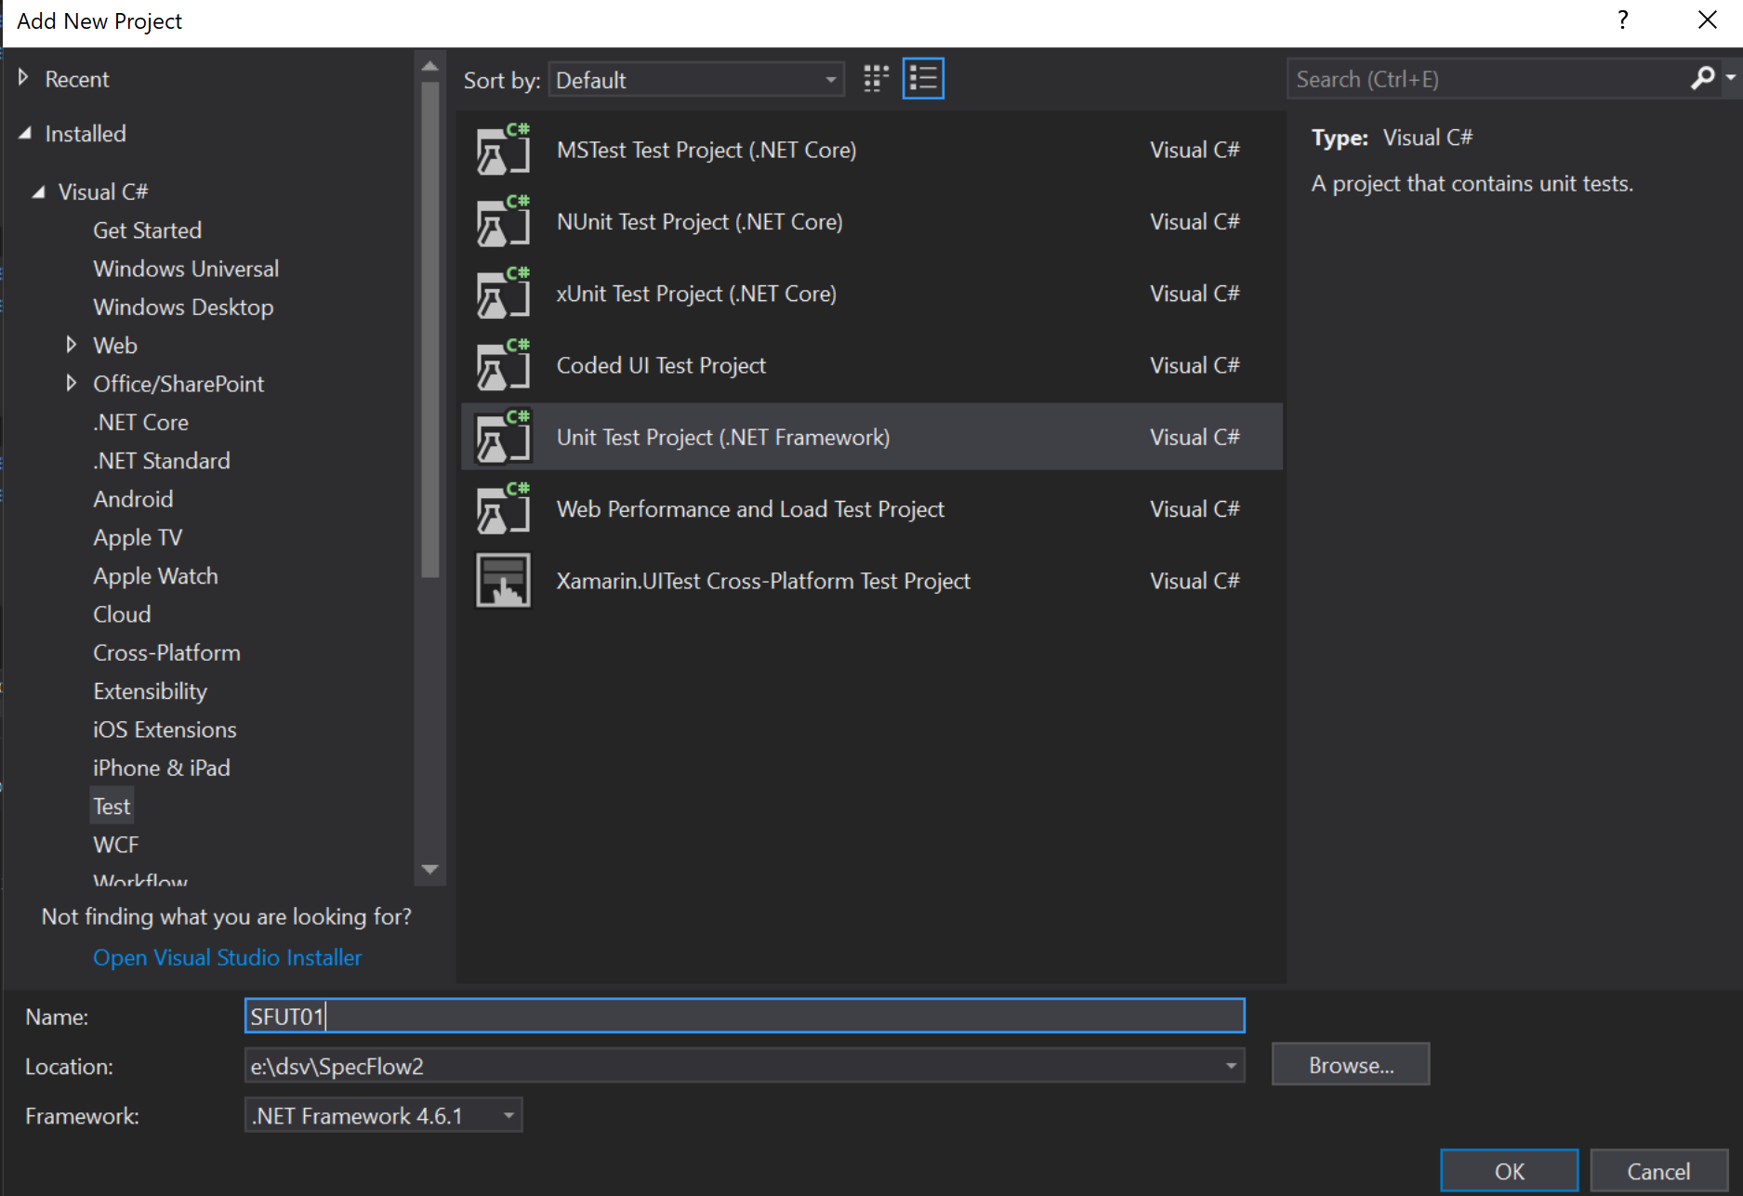
SpecFlow C# Project
Create a new Unit Test Project on Visual Studio
You can remove the dummy Unit Test class (UnitTest1.cs) that the template creates automatically.
For our example, we will use NUnit.
If you want to use another framework (XUnit or MSTest), they are both supported but you will need to spend some time configuring packages.
NUnit is straightforward with these instructions.

Slide 14
NuGet Packages and References
Add the following NuGet packages to the project:
nunit
NUnit.Console
NUnit3TestAdapter
NUnitV2.Core
SpecFlow
SpecFlow.NUnit
SpecFlow.NUnit.Runners
Add reference to:
Microsoft.CSharp

Slide 15
Adding features
Right-click at the project, select Add/New Item and then select SpecFlow Feature File.
Provide a name, preferably, the name of the feature that you are about to develop. In out example, I am using RegisterFunction.feature.
We get the following (rather silly) feature file:
Feature: RegisterFunction
In order to avoid silly mistakes
As a math idiot
I want to be told the sum of two numbers
@mytag
Scenario: Add two numbers
Given I have entered 50 into the calculator
And I have entered 70 into the calculator
When I press add
Then the result should be 120 on the screen

Slide 16
Feature description
The first four lines of a feature file comprise a header in this format:
Feature: Terse, descriptive text of what is desired
In order to realize a named business value
As an explicit system actor
I want to do something
As an example, I can say that:
Feature: Register CloudScript Csharp Azure Function
In order to use XC functions
As a game developer
I need to register the function first

Slide 17
Feature: RegisterFunction
In order to use XC functions
As a game developer
I need to first register the function
Background:
Given I have a XC account with a title
@RegisterFunction @Successful
Scenario: Register function for the first time
And Title has no registered functions
When I register a function with an Azure Function URL that returns "F1"
Then The register function call succeeds
And I can execute the function
And The function returned "F1"
@RegisterFunction @Successful
Scenario: Register function again
And Title has no registered functions
When I register a function with an Azure Function URL that returns "F2"
Then The register function call succeeds
And I can execute the function
And The function returned "F2"
@RegisterFunction @Unsuccessful
Scenario: Register function with invalid Entity Token
But I inform an invalid Entity Token
When I register a function with an Azure Function URL that returns "F1"
Then The register function call fails with a "Forbidden" status
@RegisterFunction @Unsuccessful
Scenario: Register function with nonsensical URL
When I register a function with a nonsensical URL
Then The register function call succeeds
But I get a "InternalServerError" status when I execute function
Example Scenarios
Register function for the first time;
Register function again;
Register function without proper authentication;
Register function with nonsensical URL;

Slide 18
Rule of Thumb for Scenarios:
Instead of:
Scenario: Successful log in
Use this:
Scenario: Successful log in
Given I go to URL "https://devservices.devservices.XC.com/en-US/sign-up"
And I have entered "rosiclendia@gmail.com" into element "Data_UserEmail"
And I have entered “asdf(*&22" into element "Data_Password"
And I click the "LOG IN" button
When I click the "LOG IN" button
Then The element "NEW STUDIO" should be on the screen
Given A user goes to XC Sign-up page
When A user tries to log in with existing user name and correct password
Then The log in should succeed
Describe what a user will do in the scenario, not how the user (much less, you or your system) will do.

Slide 19
Generating Step Code
After we create our feature file, we can create the associated C# step code.
Right-click at any scenario in the feature file, then select "Generate Step Definitions".
Make sure the "Style" is "Regular expressions in attributes", and click on "Generate".
You will notice that the text in the steps are not purple anymore. That's because they have step code bound to each step.
Right-click on any step and you can choose "Go to step definition".
You will notice that all steps have the same body:
ScenarioContext.Current.Pending();
This means we haven't implemented the tests yet.

Slide 20
Step Code for our Example, initializations
namespace SFUT01
{
using NUnit.Framework;
using TechTalk.SpecFlow;
[Binding]
public class RegisterFunctionSteps
{
XCRESTHelper _XCRESTHelper;
[BeforeScenario]
public void InitializeScenario()
{
_XCRESTHelper = new XCRESTHelper();
_XCRESTHelper.GetEntityToken();
}

Slide 21
Step Code for our Example, Givens
[Given(@"I have a XC account with a title")]
public void GivenIHaveAXCAccountWithATitle(){}
[Given(@"Title has no registered functions")]
public void GivenTitleHasNoRegisteredFunctions(){}
[Given(@"I inform an invalid Entity Token")]
public void GivenIInformAnInvalidEntityToken() =>
_XCRESTHelper.EntityToken += "*";

Slide 22
Step Code for our Example, Whens
[When(@"I register a function named (.*) with an Azure Function URL that returns ""(.*)""")]
public void WhenIRegisterAFunctionWithAnAzureFunctionURLThatReturns(
string functionName, string expectedReturn) =>
SetV("RegisterFunctionResult",
_XCRESTHelper.RegisterFunction(functionName,
expectedReturn == "F1"
? Constants.F1URL
: Constants.F2URL));
[When(@"I register a function named (.*) with a nonsensical URL")]
public void WhenIRegisterAFunctionNamedFunctionNameWithANonsensicalURL(string functionName) =>
SetV(“RegisterFunctionResult",XCRESTHelper.RegisterFunction(
functionName, "https://completeNonsense.net"));
[When(@"I execute a function that is not registered")]
public void WhenIExecuteAFunctionThatIsNotRegistered() =>
SetV("ExecuteFunctionResult", _XCRESTHelper.ExecuteFunction("NotRegisteredFunction",new{}));

Slide 23
Step Code for our Example, Thens
[Then(@"The register function call succeeds")]
public void ThenTheRegisterFunctionCallSucceeds() =>
Assert.IsTrue(XCRESTHelper.Succeeded(GetV("RegisterFunctionResult").StatusCode));
[Then(@"I can execute the function (.*)")]
public void ThenICanExecuteTheFunction(string functionName)
{
var result = _XCRESTHelper.ExecuteFunction(functionName, new { });
Assert.IsTrue(XCRESTHelper.Succeeded(result.StatusCode));
SetV("ExecuteFunctionResult", result);
}
[Then(@"The function returned ""(.*)""")]
public void ThenTheFunctionReturned(string expectedResult) =>
Assert.AreEqual(expectedResult,
GetV("ExecuteFunctionResult").Result["data"]["FunctionResult"]["result"].Value);

Slide 24
Step Code for our Example, Thens, part 2
[Then(@"The register function call fails with a ""(.*)"" status")]
public void ThenTheRegisterFunctionCallFailsWithAStatus(string expectedStatus) =>
Assert.AreEqual(expectedStatus, GetV("RegisterFunctionResult").StatusCode.ToString());
[Then(@"I get an ""(.*)"" status when I execute the function (.*)")]
public void ThenIGetAStatusWhenIExecuteFunction(string expectedStatus, string functionName) =>
Assert.AreEqual(expectedStatus,
_XCRESTHelper.ExecuteFunction(functionName, new { }).StatusCode.ToString());
[Then(@"The execute function call fails with a ""(.*)"" status")]
public void ThenTheExecuteFunctionCallFailsWithAStatus(string expectedStatus) =>
Assert.AreEqual(
expectedStatus,
GetContextValue("ExecuteFunctionResult").StatusCode.ToString());

Slide 25
Step Code: Scenario Context
SpecFlow has a class ScenarioContext, with a static dictionary Current where we can store values across steps, among other capabilities.
private void SetV (string name, ResultWrap value) =>
ScenarioContext.Current[name] = value;
private ResultWrap GetV (string name) => (ResultWrap)ScenarioContext.Current[name];

Slide 26
Refactoring: Add a new scenario
In case you need to add a new scenario, such as:
@RegisterFunction @Unsuccessful
Scenario: Trying to execute a function that is not yet registered
When I execute a function that is not registered
Then The execute function call fails with a "BadRequest" status
Enter the new scenario in the .feature file, right-click on the steps (they should be purple, indicating they do not have code behind), then select Generate Step Definition.
However, this time, instead of clicking in the "Generate" button, click on the "Copy methods to clipboard", then go to the Steps.cs file and paste the new code.
If you click on "Generate", your previous code will be overwritten.

Slide 27
Refactoring: Changing step parameters
When you change the step description in the .feature file, you will notice that the step will turn purple, meaning it is not bound to code behind.
In order to fix this, go to the *Steps.cs file, find the method that was associated with the step, and update the regular expression at the Given/Then/When parameters.
 | Before Changing | After Changing
Feature file | And The function returned "F2" | And The function returned F2
*Steps.cs file | [Then(@"The function returned ""(.*)""")] public void ThenTheFunctionReturned( string expectedResult) => | [Then(@"The function returned (.*)")] public void ThenTheFunctionReturned( string expectedResult) =>

Slide 28
Scenario Outline
When we have a set of tests that are similar, differing only on parameters, we can create scenario outlines to avoid repetition. For instance:
Feature: LoginWithScenarioOutline2
In order to use XC portal
As a Studio user
I need to log in
@LoginWithScenarioOutline
Scenario Outline: Login with different outcomes
Given I go to XC Login page
When I try to log in with "<UserName>" and "<Password>"
Then "<ExpectedText>" should be displayed
Examples:
| UserName | Password | ExpectedText |
| rosiclendia@gmail.com | Rosi.1976 | NEW STUDIO |
| rosiclendia@gmail.com | WrongPass | Could not log in: Invalid username or password |
| nonexistent@account.com | AnyPass | Could not log in: User not found |
Notice that the parameters are in angle brackets (<UserName>, <Password>, <ExpectedText>), which are the headers in the table under Examples.

Slide 29
Scenario Outline: Generated Code
When we generate the step definitions, we will have only 3 steps, with the parameters being passed to the step definitions:
[Binding]
public class LoginWithScenarioOutline2Steps
{
[Given(@"I go to the XC Login page")]
public void GivenIGoToTheXCLoginPage()
{
ScenarioContext.Current.Pending();
}
[When(@"I go log in with ""(.*)"" and ""(.*)""")]
public void WhenIGoLogInWithAnd(string p0, string p1)
{
ScenarioContext.Current.Pending();
}
[Then(@"""(.*)"" is displayed")]
public void ThenIsDisplayed(string p0)
{
ScenarioContext.Current.Pending();
}
}

Slide 30
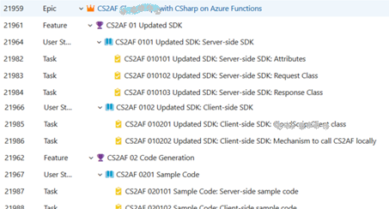
SpecFlow and Azure Devops Work Items
A .feature file in SpecFlow should be associated with a Feature in Azure Devops
A scenario should be associated with a User Story or Tasks.
Feature: CSAF 01 Updated SDK
In order to use the new CS2AF
As a game developer
I need to use the updated SDK
@CS2AF @SDK @Server
Scenario: CS2AF 0101 Updated SDK Server Side SDK Attributes
Given I have a XC account with a title
When I create a new Cloud Script Azure Function
And I apply an attribute to the Cloud Script Azure Function
And I compile and publish the Cloud Script Azure Function
Then The Cloud Script Azure Function will have the attribute
@CS2AF @SDK @Server
Scenario: CS2AF 0101 Updated SDK Server Side SDK Request Class
. . .

Slide 31
Resources
https://sdtimes.com/test/overcoming-the-challenges-of-adopting-behavior-driven-development-in-the-enterprise/
https://docs.cucumber.io/bdd/overview/
http://behaviourdriven.org/
https://app.pluralsight.com/library/courses/specflow-2-0-business-readable-automated-tests/table-of-contents
http://dannorth.net/
http://lizkeogh.com
https://gojko.net/posts.html
https://link.springer.com/chapter/10.1007/978-3-658-09994-7_11
https://www.infoq.com/news/2015/02/bdd-ddd
https://lizkeogh.com/cynefin-for-developers/
https://msdn.microsoft.com/en-us/magazine/gg490346.aspx
https://pdfs.semanticscholar.org/ec7f/474575ebf839d7cf740d9e8d60c8b6725851.pdf
http://athena.ecs.csus.edu/~buckley/CSc170_F2018_files/The%20Beginners%20Guide%20to%20BDD.pdf

